Slide 1

IMPROVED PRIORITY EXCHANGE SERVER
COURSE: REAL-TIME SYSTEMS
PREPARED BY
ABDUL-AZEEZ OLANLOKUN
June 2022

Slide 2

MOTIVATION

Slide 3
ASSUMPTIONS
To define our algorithm we assume the following
Every periodic tasks ti : i = 1,..,n have hard deadlines;
Every aperiodic task Ji: i = 1,....,m do not have deadlines;
Each aperiodic request entering the system has a known execution time but does not have an arrival time;
Every periodic task starts at t=0, and their close deadlines are equal to the periods

Slide 4
IMPROVED PRIORITY EXCHANGE SERVER DEFINITION
The IPE server improves the responsiveness of DPE by making periodic tasks as late as possible.
Regardless of the deadline of any other tasks, it runs as the highest priority task if there is capacity.
capacity is replenished at precomputed times with a precomputed value, if this is not the case, then it is the same as DPE.
Its other rules (aperiodic requests and periodic instances executions, exchange and consumption of capacities) are the same as for a DPE server but with a bigger memory demand.

Slide 5
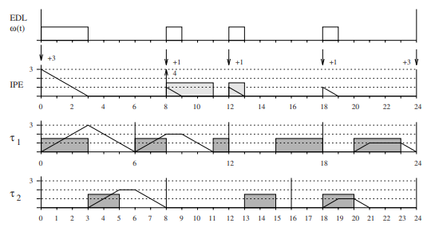
Example of an IPE server taken from [1]

Slide 6
SCHEDULABILITY OF AN IPE Server
The IPE Server schedulability is defined as:
for each execution of a periodic instance during a dead-line exchange (i.e., a rise in the associated aperiodic capacity), it is delayed until the capacity is exhausted.
Therefore, "the whole set is schedulable If and Only If"[2]:
Up ≤ 1
"the server allocates automatically the bandwidth 1 −Up to aperiodic requests"[2]

Slide 7


RESOURCE CLAIMING OF AN IPE SERVER
The same as with the DPE server, resource reclaiming, that is, reclaiming unused periodic execution time, is possible.

Slide 8
IPE AND EDL COMPARISON
The Images below depicts three graphs that correlate to three distinct periodic loads: low, medium, and high.
The aperiodic load was created by taking the mean interarrival time Ta = 100 and adjusting the average aperiodic service time Ts so that the total load encompassed the range from Up to full processor usage.

Slide 9
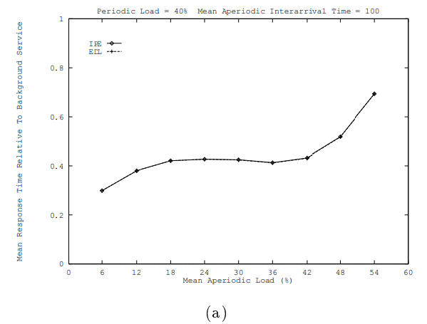
taken from [3]

Slide 10
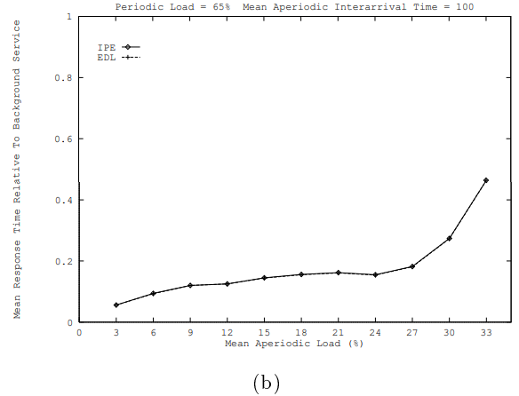
taken from [3]

Slide 11
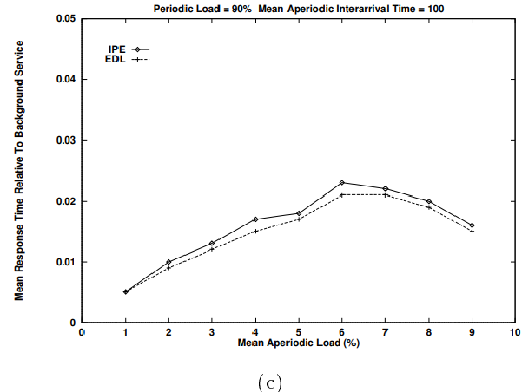
taken from [3]

Slide 12
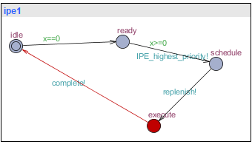
UPPAAL IMPLEMENTATION

Slide 13
CONCLUSION

Slide 14
REFERENCES
[1] C. Buttazzo, Hard Real-Time Computing Systems, vol. 24. Boston, MA: Springer US, 2011. doi: 10.1007/978-1-4614-0676-1.
[2] Liu, C.L., and Layland, J.W., ”Scheduling Algorithms for Multiprogramming in a Hard real-Time Environment,” Journal of the ACM 20(1), 1973, pp. 40-61
[3]Lehoczky, J.P., and Ramos-Thuel, S., ”An Optimal Algorithm for Scheduling Soft-Aperiodic Tasks in Fixed-Priority Preemptive Systems,” Proc. of Real-Time Systems Symposium, 1992, pp. 110-123.

Slide 15


